Slide 1
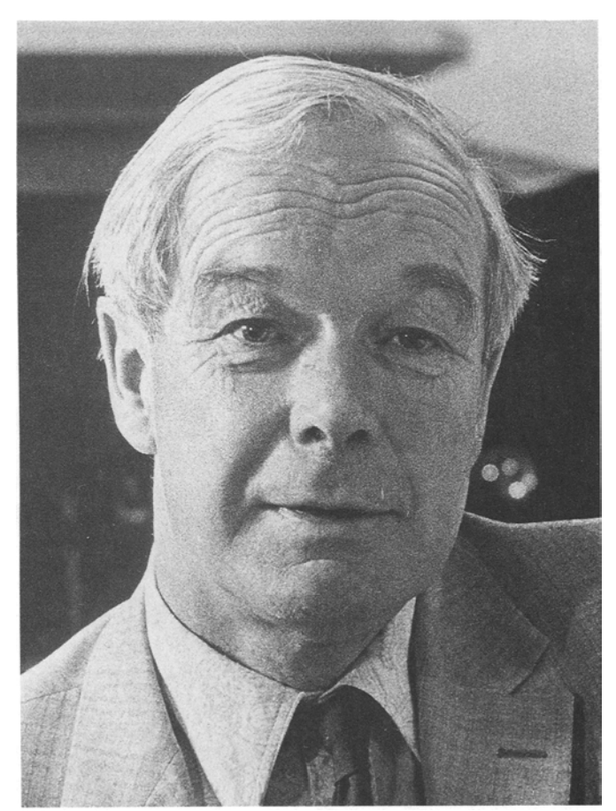
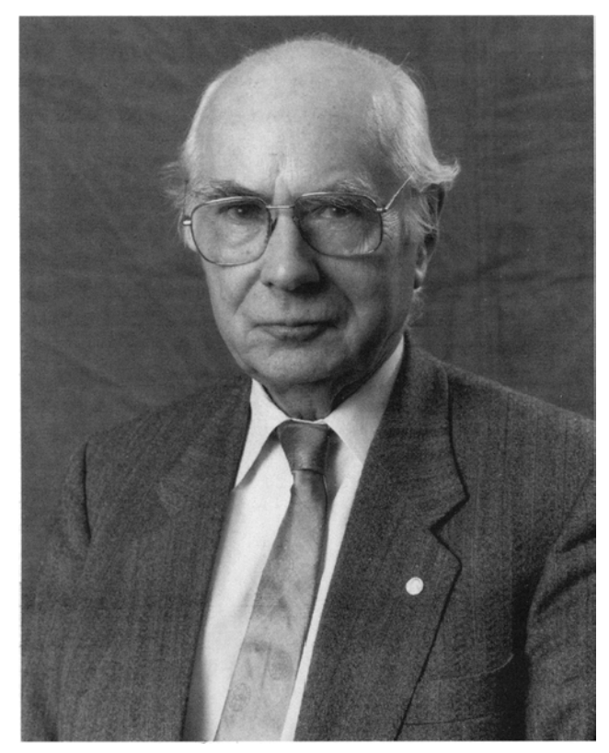
Hodgkin - Huxley
Model of excitability
Jesse Kaminsky

Slide 2
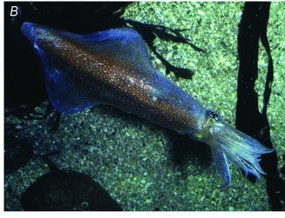
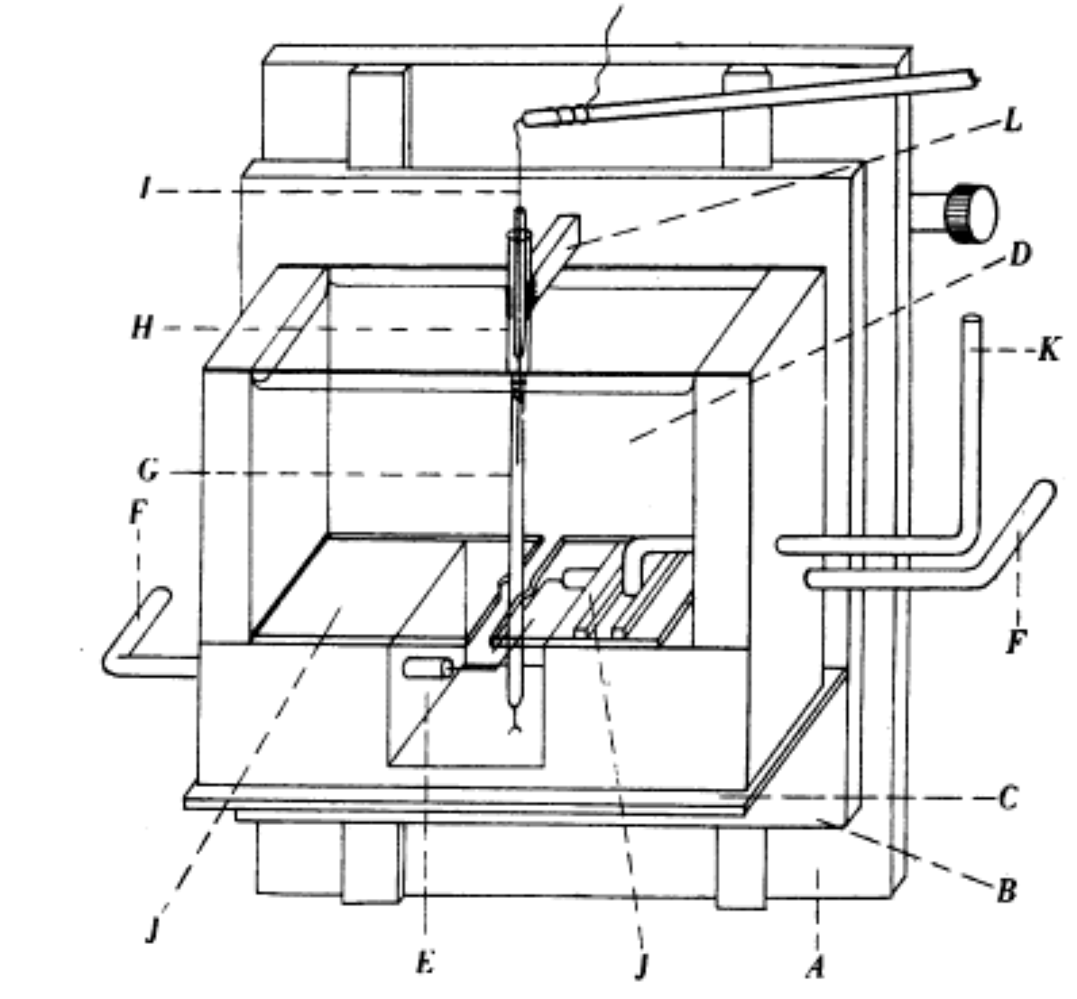
The big question
Schwiening, 2012
How is it that nerves conduct information?
What was known
Gross anatomy of the neuron, nervous cells have axons along which information is propagated via depolarization. Giant squid axon discovered by John Zachary Young in the 30s, enabling easier dissection and study. Current is passed using ions.
Action potentials exist… and conductance increases during them
H&H developed a way to probe the axonal membrane
First intracellular recording of an action potential
Kenneth Cole and Howard Curtis also did this the same year but could not simultaneously record resting membrane potential
H&H, 1945

Slide 3
What’s going on with nerve cells?
What is conducting down these big tubes? - Hodgkin learned to dissect giant squid axons with Kenneth Cole.
Is axoplasm viscous enough to allow flow of… something? H&H tried placing mercury droplets on the axon, but they just sat there. Axoplasm is a gel??? So it could maintain a voltage, stick a wire in it.
Discovered that the action potential reaches a much greater potential than resting membrane potential. Wrong theories abound.
Work interrupted by World War II. Hodgkin would work on designing oxygen masks and radar (control systems). Huxley would work on predictive targeting for guns (math stuff). They came back to equipment damaged by air raids.

Slide 4
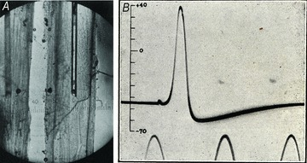
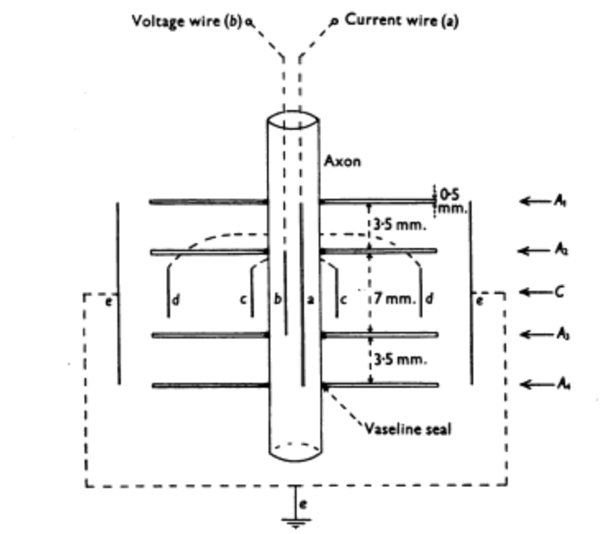
The action potential characterized
Schwiening 2012
Bernard Katz then discovers it is influenced by the concentrations of various ions found in seawater, such as sodium and potassium
Voltage clamp
Using paired electrodes, one inside and several outside the axon, as well as a stimulating electrode (that can generate current), the membrane could be held at a specific voltage (a control system). Also, this allowed simultaneously measuring currents across the membrane.
Hodgkin, Huxley, and Katz, 1952

Slide 5
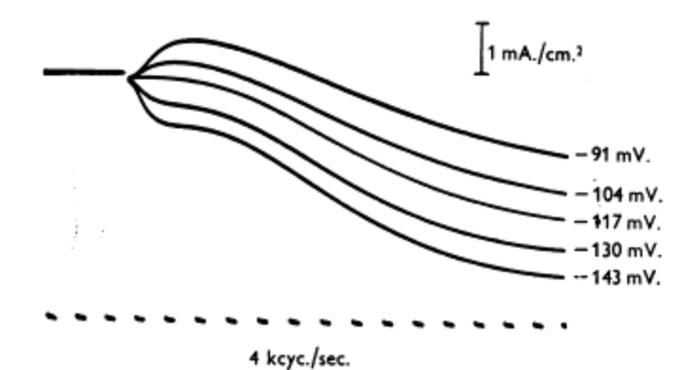
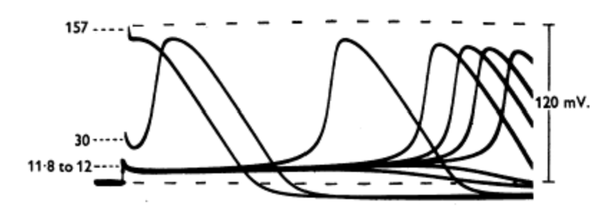
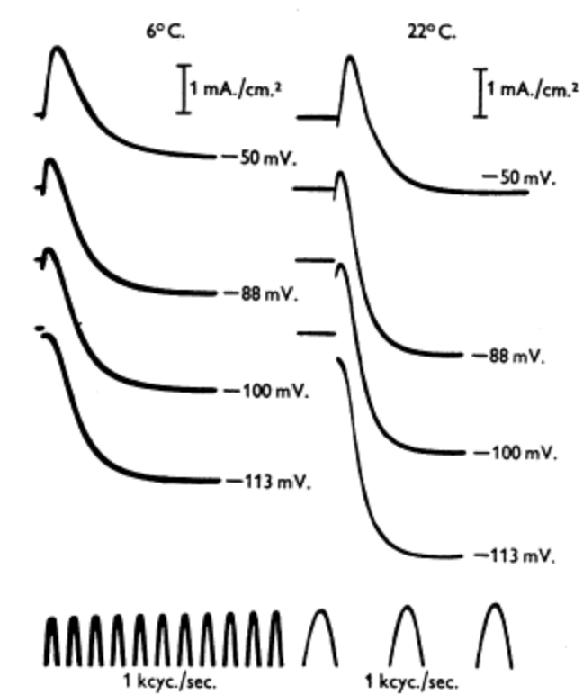
Voltage clamp allows you to measure currents
Developed by Kenneth Cole and John Marmont
Voltage follows particular trajectories following the injection of current.
Current follows particular trajectories when voltage is clamped (math stuff).
This implies that the currents that generate the action potential are voltage and time dependent.
They also found they were temperature dependent.
Hodgkin, Huxley, and Katz 1952

Slide 6
So, given all this
What would you do now to try and understand the generation of the action potential and how voltage and current are passed across/through the axonal membrane?
Onto their paper.

Slide 7
Why should current depend on equilibrium potential?
A charged particle near a permeable membrane is subject to two main forces:
Electromagnetic force due to voltage across the membrane
Moving along its concentration gradient (arises from kinetic forces and Brownian motion)
If we take concentration gradients to be fixed, then there is exactly one voltage where these two forces perfectly counteract each other
(an important note: The numbers of ions needed to change membrane voltage is MUCH smaller than the numbers that define the concentration gradient)

Slide 8
Why does any of this matter?
What are you trying to do when you develop a model?
Does reproducible, near-perfect prediction of held-out data imply that your model is correct? Does it mean you “understand” the phenomena of interest? Hodgkin-Huxley considered their work a failure because it didn’t explain the mechanisms underlying the equations they produced. They knew how ion conductance changed with time and voltage, but not how it happened in real cells.
Their model is objectively wrong, but the reasons that it worked related to what would become the working model for how action potentials are truly generated.
72, 79, 86, 96, 103, 110, 116, 125, 137, 145, 157, 168, 181, 191…

Slide 9
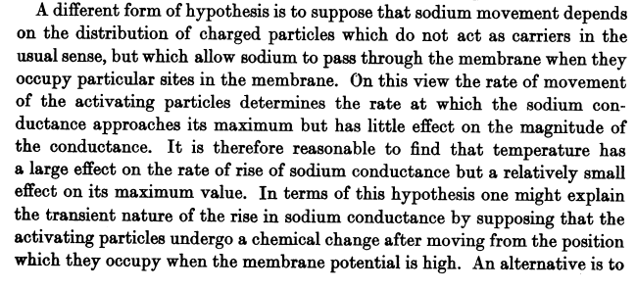

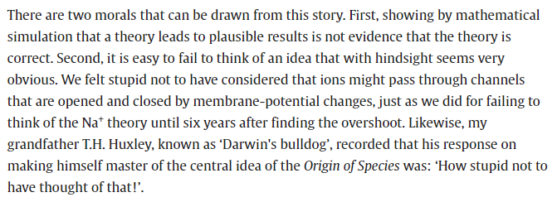
H&H 1952
Huxley 2002

Slide 10
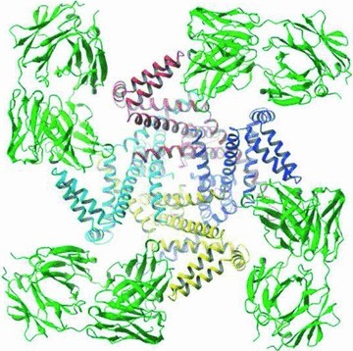
Schwiening 2012
We now know the mechanism underlying the voltage dependence of ionic conductances across the cell membrane. Ion channels are extremely consistent with H&H’s description of potential mechanisms.

